Slide 1

Best Book to Read
in 2021
Team 2
Team members: Chuangwei Qing, Min Jia, Qidi Xu, Xianzhou Pan, Zhao Zhang

Slide 2

Contents
Objective and Purpose
Design Document
Final ERD
DDL for implementing
Two SQL views
Two report PowerBI

Slide 3

Objective and Purpose
WHAT
We create a database maintained the data used to track and report purchasing books’ records, provide information of worth buying books, and supply marketing insights.
The database will be used by the team administrative, bookstores, and customers.

Slide 4

Objective and Purpose
HOW
Provide suggestions and descriptions of books worth reading for customers.
Attract and initiate different customers to buy books.
Supply proper marketing strategies for publishers to drive targeted marketing initiatives.
Provide authors with the most popular book types to cater to the interests of customers.
Allow customers, publishers, managers to query books' information.

Slide 5
Design Document
Entity Name | Why Entity Included | How Entity is Related to other Entities
Books | Collect information about the book’s elements | Core entity
AwardGettingInfo | Show the award of a book won and recommend worth-buying books | Related to Books and Awards entity
Awards | Show the names of awards | Related to AwardGettingInfo entity
Genres | Store specific genres | Related to Category entity
Series | Store series of books | Related to Books entity
Category | Associative entity | Related to Books and Genres entity
MainCharacters | Provide information of main characters in the book | Related to BooksHasMainCharacters entity
BooksHasMainCharacters | Associative entity | Related to Books and MainCharacters entity

Slide 6
Design Document
Entity Name | Why Entity Included | How Entity is Related to other Entities
Orders | Track each transaction for book sales | Related to Sellers, Customers, and Books entity
Sellers | Collect sellers’ information | Related to Orders entity
Customers | Collect customers’ information | Related to Orders entity
Publisher | Collect publishers’ information | Related to Books entity
Authors | Collect authors’ information | Related to Books entity
BBEList | Provide information worth buying books | Related to Books entity

Slide 7
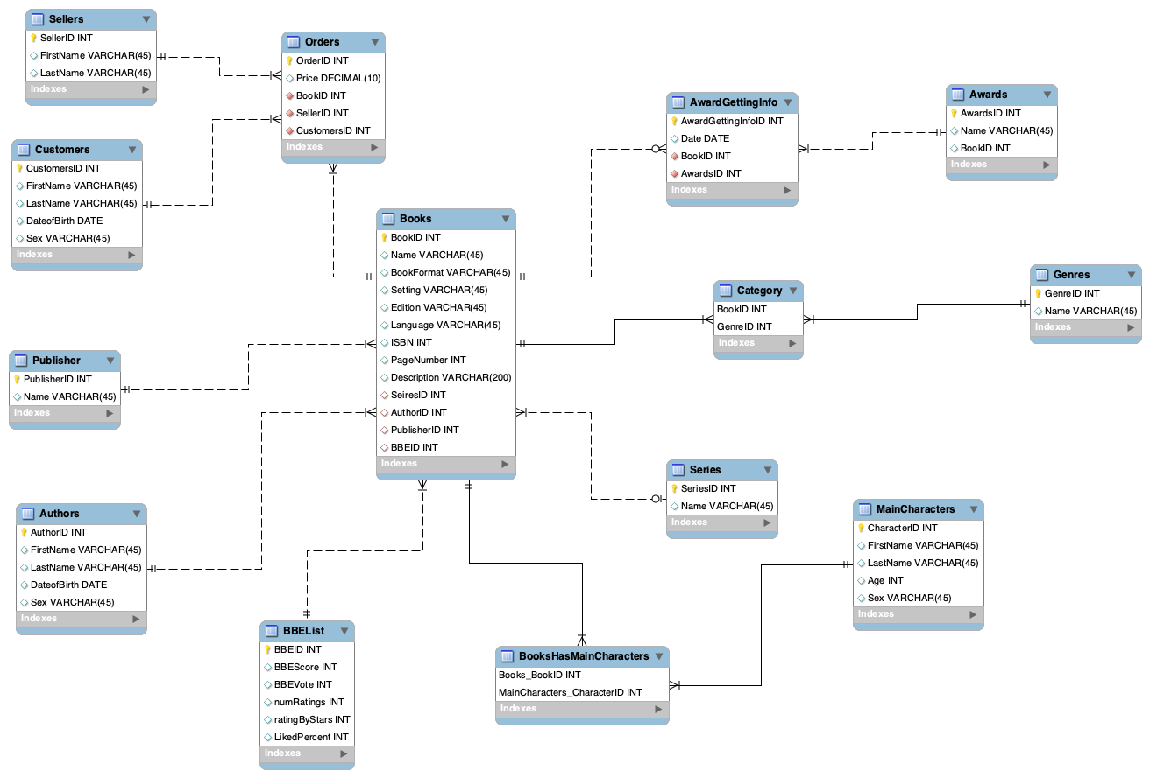
Final ERD

Slide 8
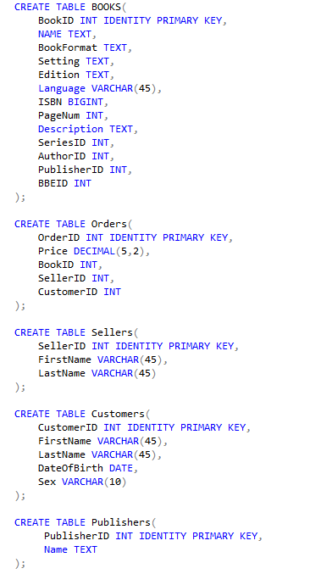
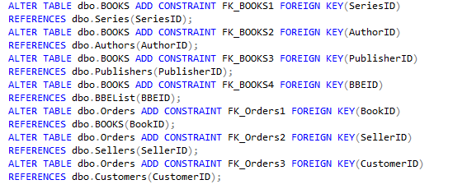
DDL
Create16 tables
Reinforce Primary Keys
Reinforce Foreign Keys
Types:
INT
TEXT
VARCHAR
………..
Alter tables to add foreign key relationship

Slide 9
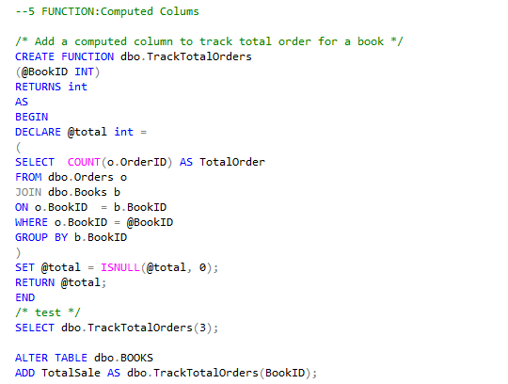
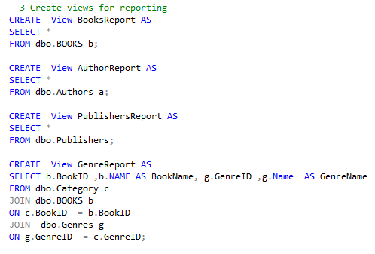
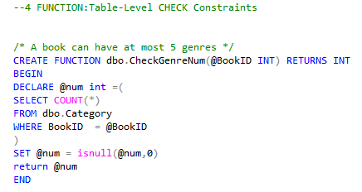
DDL
Create 9 Computed Columns:
Track status of objectives stated in P1
Track some interesting or useful information
Track necessary information(age and so on)
Create 12 Views for reporting purpose
Create 3 Check Constraints:
A book can have at most 5 genres
A book has no sale can not be on BBE list
A book with user rating less than 3.0 can not get a reward

Slide 10
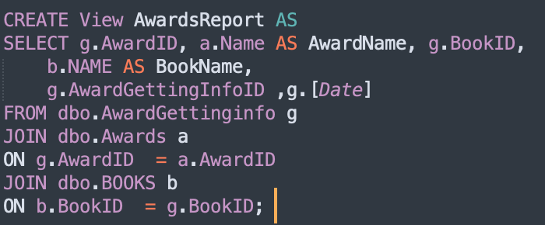
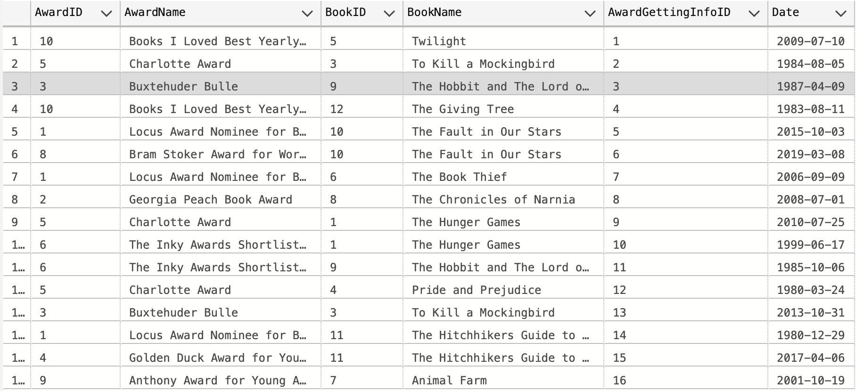
Views of SQL
To report on awards

Slide 11
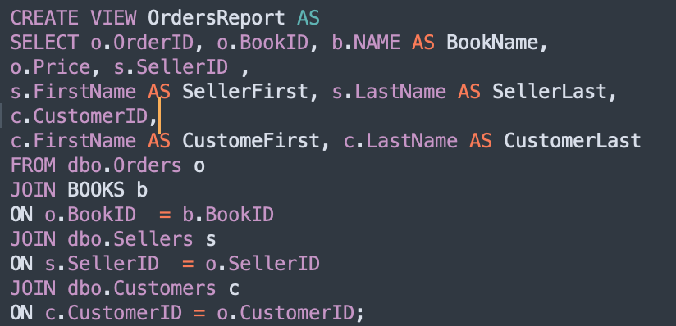
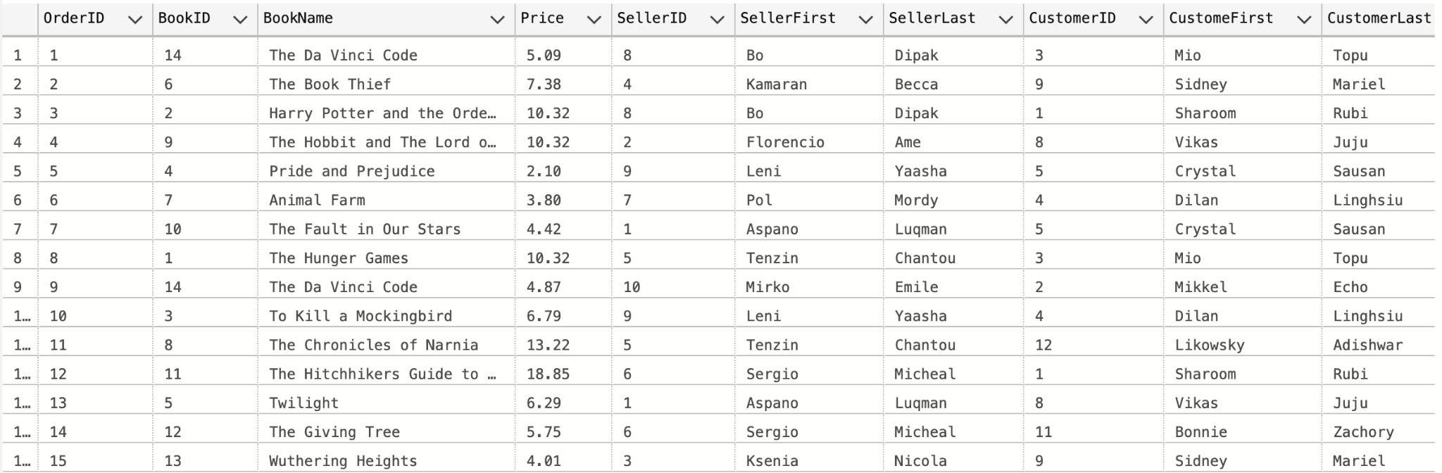
Views of SQL
To report on book orders

Slide 12
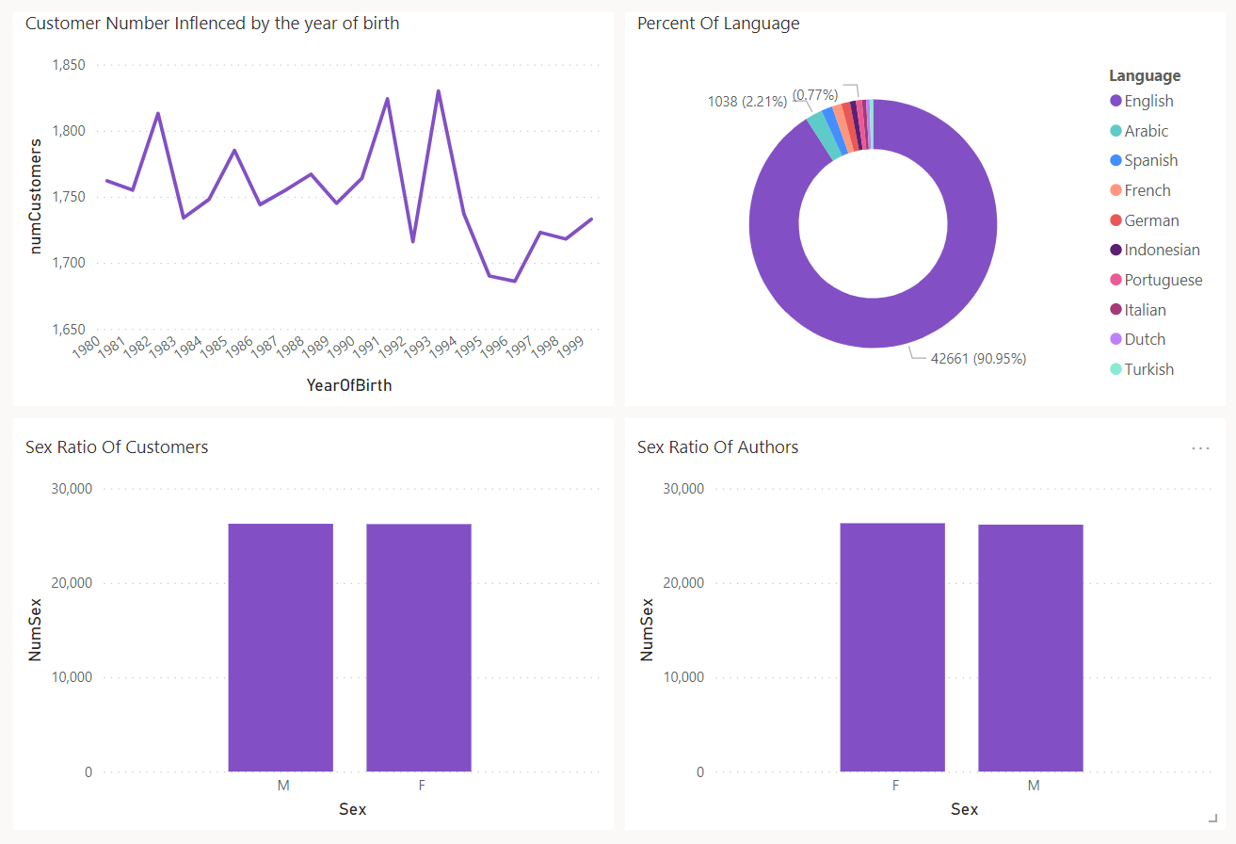
Views of powerBI

Slide 13
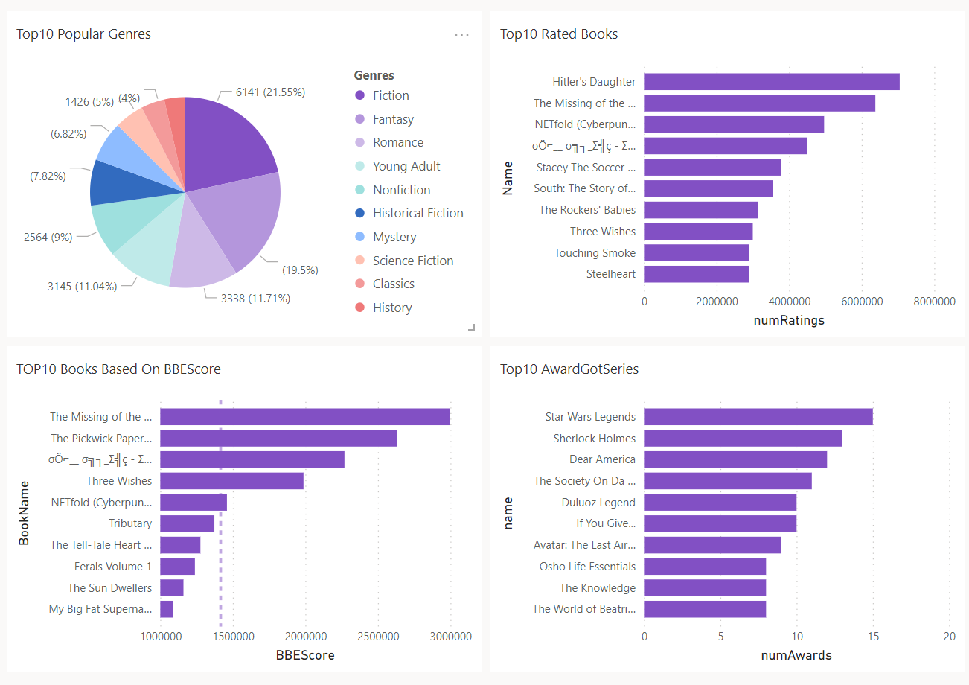
Views of powerBI

Slide 14

Conclusion
What we have done:
Basic DDL
Import Data
Simple Queries and Views for reporting
Functions for computed column and check constraints
What we still improve:
More complicated Queries for reporting
Encrypt
More useful entity and attributes
Triggers to reinforce constraints
More Data

Slide 15
Q & A

